Slide 1


AI vs Human Tweets
Using TF-IDF + Logistic Regression
PRESENTED BY :
DHANANJAY K.N
MADAN R
GURUKIRAN J.S
RAKESH S
PRESENTED TO :
UMESH D.K
&
MY CLASSMATES

Slide 2

INTRODUCTION
THIS IS MY PROJECT ON CLASSIFYING WHETHER A TWEET WAS WRITTEN BY A HUMAN OR GENERATED BY AI, USING MACHINE LEARNING

Slide 3

Problem Statement
AI-GENERATED TWEETS ARE INCREASING.
FAKE ACCOUNTS SPREAD MISINFORMATION.
GOAL: BUILD A MODEL TO DETECT HUMAN VS AI TWEETS.
Nowadays, AI models like GPT can write tweets, and bots spread fake information. Our goal is to build a system that can check if a tweet is from a human or an AI.

Slide 4

Dataset
Dataset : TweepFake (Kaggle).
Important columns :
• text → the tweet itself
• class_type → (Human, GPT2, RNN, etc.)
• account.type → target Human / Bot
Features : text
Label : account.type
We used a dataset called TweepFake from Kaggle. It contains tweets, info about the account type, and whether the tweet was human or AI-generated. Our input was the tweet text and account type, and the output label was the class type.

Slide 5
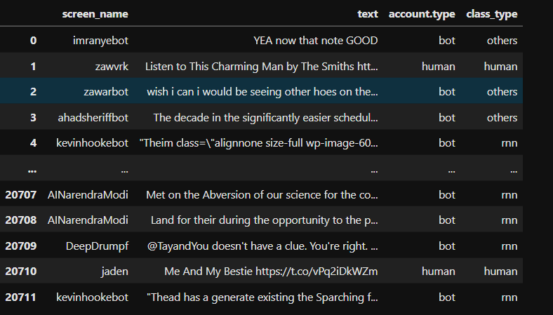

Slide 6

Preprocessing
Removed unnecessary columns.
Converted account.type into numbers (Human=0, Bot=1).
Used TF-IDF to convert text into numbers (max 5000 words, bigrams).
Combined text features with account type.
Since machine learning can’t work with raw text, we had to process it. We cleaned the data, converted account type into numbers, and applied TF-IDF — which basically turns text into numeric features. Then we combined text and account info together.

Slide 7
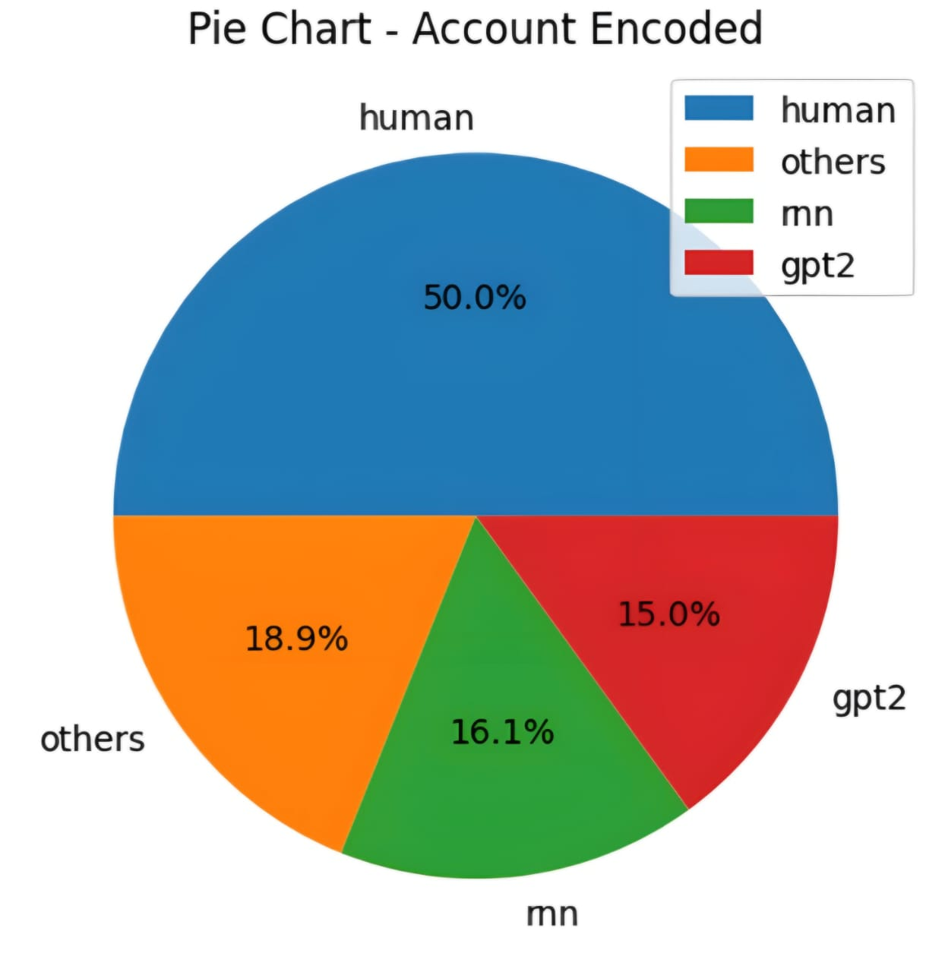
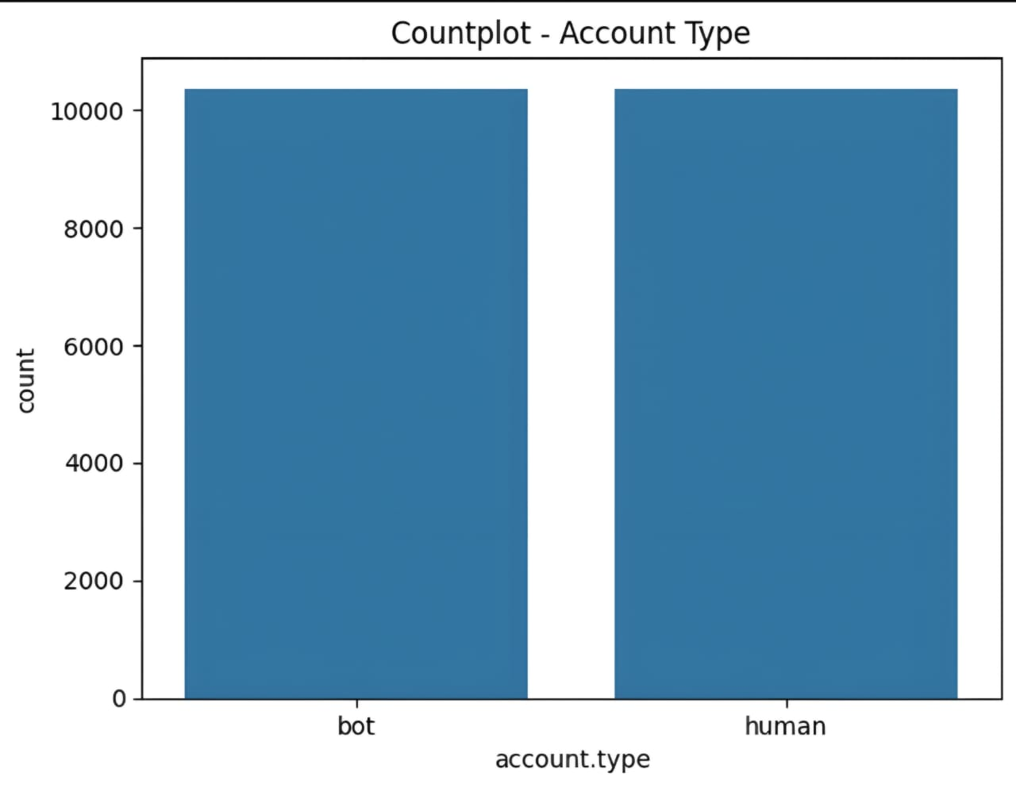
GRAPHS

Slide 8
Pipeline / Methodology
Load dataset
Preprocess text + encode account.type
TF-IDF Vectorization
Combine features
Train Logistic Regression model
Evaluate results
This was our pipeline: start with data, preprocess it, apply TF-IDF, combine features, train the Logistic Regression model, and then evaluate the performance.

Slide 9
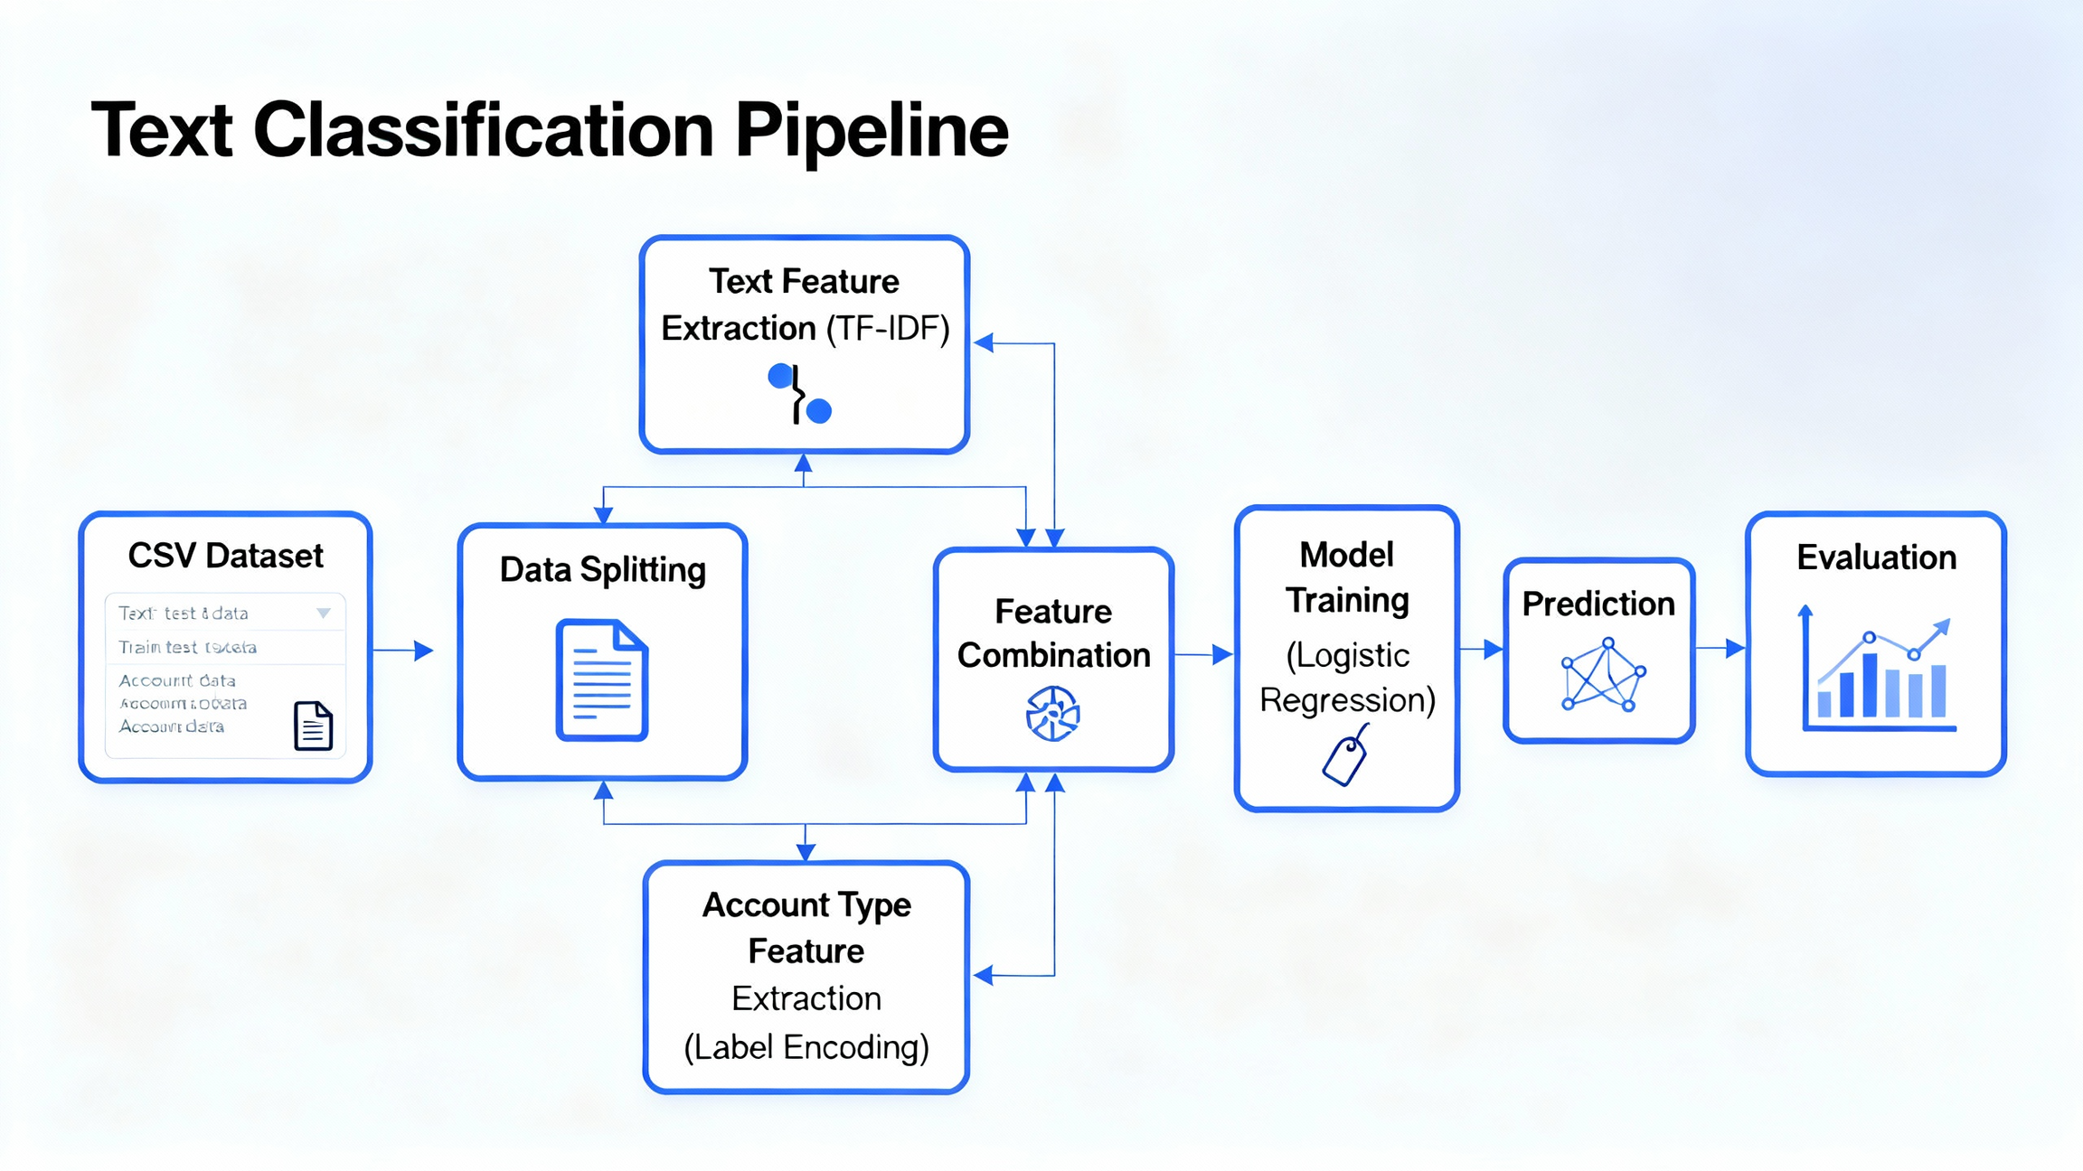

Slide 10
Model
Model: Logistic Regression
Good for classification problems
Finds the best boundary between categories
Max Iterations: 300 (enough time to learn)
Solver: lbfgs (works well with big data & multiple classes)
We used Logistic Regression because it’s simple and effective for classification. It finds the best boundary between Human and AI tweets. We gave it up to 300 steps to train properly, and used the lbfgs solver, which is efficient for big data and multiclass classification.

Slide 11
Results
Accuracy: ~76%
Confusion Matrix → shows correct vs wrong predictions
Classification Report → precision, recall, F1-score
Our model reached around 76% accuracy, which is very good. The confusion matrix shows where predictions went right or wrong. The classification report gives deeper metrics like precision and recall.

Slide 12
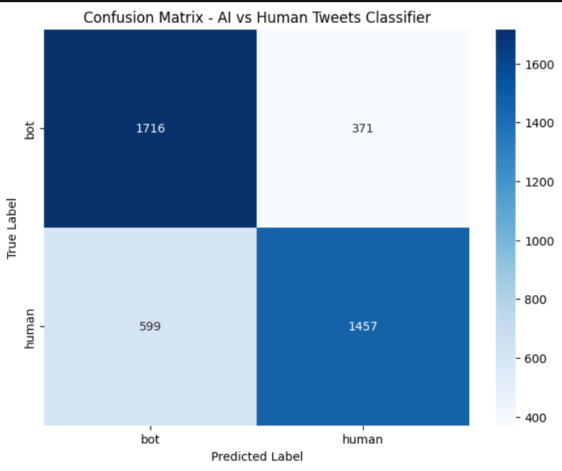
Confusion Matrix Heatmap

Slide 13
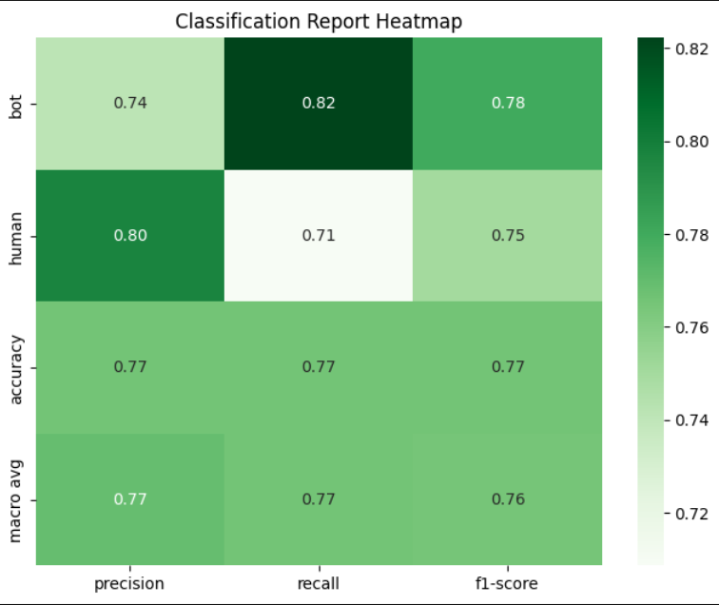
Report Heatmap

Slide 14
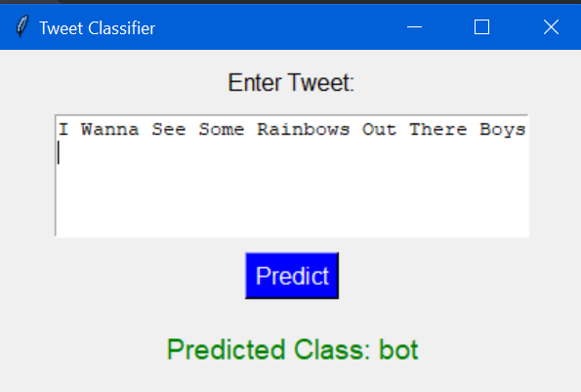
User Interface
User enters tweet.
Model predicts Human or Bot.
If wrong → user provides correct label.
System saves correction & retrains model.

Slide 15
Conclusion
Built a system to detect Human vs Bot accounts using tweet text.
Logistic Regression gave strong accuracy (~76%).
Web app with feedback → makes model self-learning.
Helps fight misinformation and bot detection on social media.

Slide 16

THANK YOU

